Slide 1
Foundation
SQL – Optimisation and Efficiency

Slide 2

Module Objectives
After completing this module you will be able to:
Explain the role and function of optimisation
Implement common optimisation techniques designed to enhance query efficiency
Demonstrate how to improve responsiveness on regularly run queries through the use of indexes

Slide 3
Optimisation and Efficiency
Explain Plan
Efficiencies
Indexes

Slide 4
What makes a good query?
Processing?
Memory?
Length?
Readability?
"Cost"?
Types of Join?
Something else ... ?

Slide 5
Explain plan
Specific to Oracle SQL Developer
An analysis of how the query would be executed
Can evaluate the cost of the query based on:
Processing
Memory
Read and/or write
Not an absolute science
One of many indicators to help optimise
Makes more sense the more you use it

Slide 6

Explain plan – How to run one

Slide 7
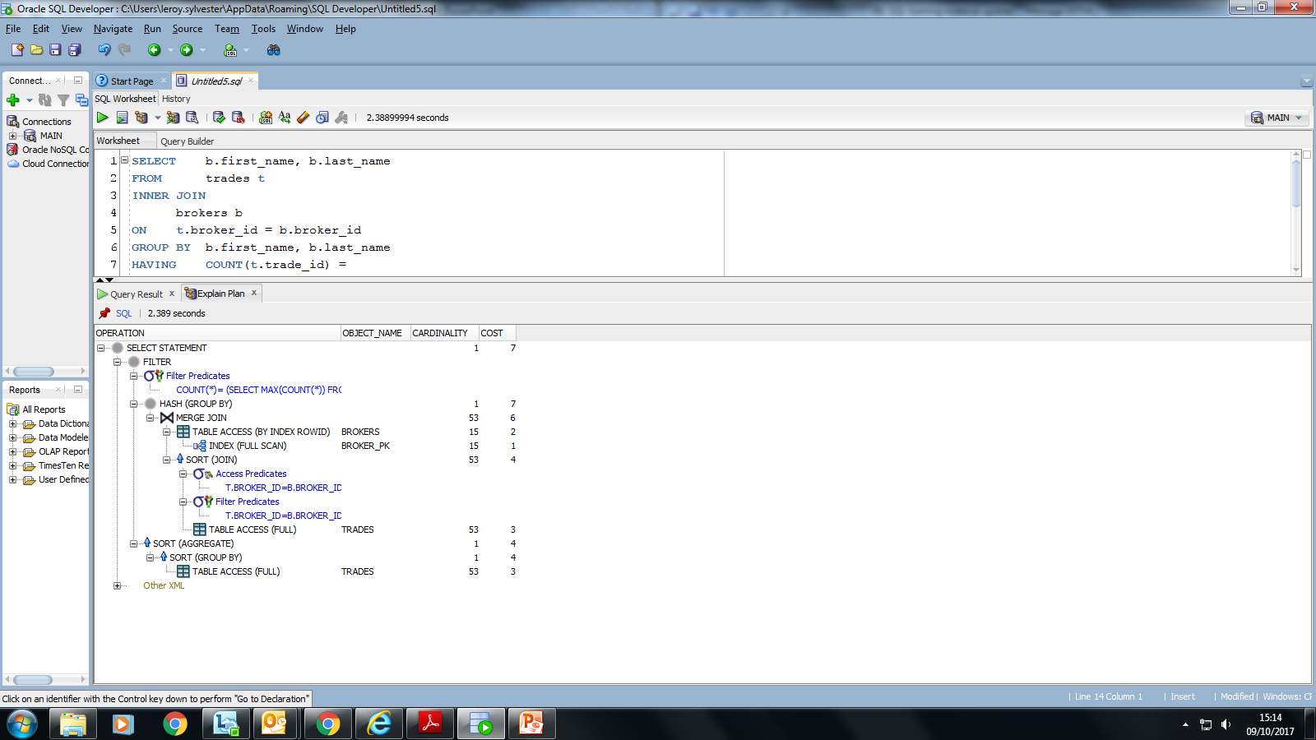
Explain plan – Result screen

Slide 8

Explain plan – Result screen

Slide 9
Optimisation and Efficiency
Explain plan
Efficiencies
Indexes

Slide 10
Efficiencies – Indexes
An index is a way to know the location of a value on the disk
Indexes are loaded into memory
WHAT?
WHY?
Faster Joins
Faster Filtering

Slide 11
Efficiencies – Indexes
Impact
Without index
With index

Slide 12
Efficiencies – Table size
Impact
Joins
Memory needed
Processing times needed
Indexes
Memory needed
Processing time for update
Filtering
Without index, cost can skyrocket
Queries
May be written differently depending on size

Slide 13
Efficiencies – Joins
Different Joins have different efficiencies
Query A
Query B
SELECT
s.share_id,
sp.price
FROM
shares s
INNER JOIN
shares_prices sp
ON
sp.share_id = s.share_id
;
SELECT
s.share_id,
sp.price
FROM
shares s
LEFT OUTER JOIN
shares_prices sp
ON
sp.share_id = s.share_id
;

Slide 14
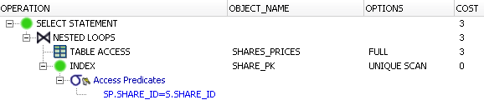
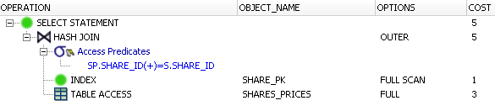
Efficiencies – Joins
Query A
Total cost = 3
Query B
Total cost = 5

Slide 15
Efficiencies – Rows
Rows in a result set
Joins
Aggregate functions
Scalar functions
Ordering
Impact
More rows returned means more processing time for each operation

Slide 16
Efficiencies – Memory
Needed for every process
Joins
Functions
Grouping
Sorting
Impact
Slows down processes as more steps are added
Data is processed in chunks

Slide 17
Efficiencies – I/O
Physical I/O
Reading datasets from the disk rather than from memory
Impact
Slowest form of I/O
More processing time for decisions

Slide 18
Efficiencies – I/O
Logical I/O
Process to decide where to read from
Indexes
Cache
Impact
Fastest I/O
More processing time for decisions

Slide 19
Optimisation and Efficiency
Explain plan
Efficiencies
Indexes

Slide 20
Indexes
Map between values in a column and their position in the table (on disk)
Avoids having to read everything within the table
Can jump straight to the relevant record(s)
CREATE INDEX
p$country
ON
places(country)
;

Slide 21
Questions

Slide 22
Review
What is optimisation?
What tools are available?
What do you measure optimisation on?
What are indexes?

Slide 23
Module Objectives
You should now be able to:
Explain the role and function of optimisation
Implement common optimisation techniques designed to enhance query efficiency
Demonstrate how to improve responsiveness on regularly run queries through the use of indexes

